Slide 1
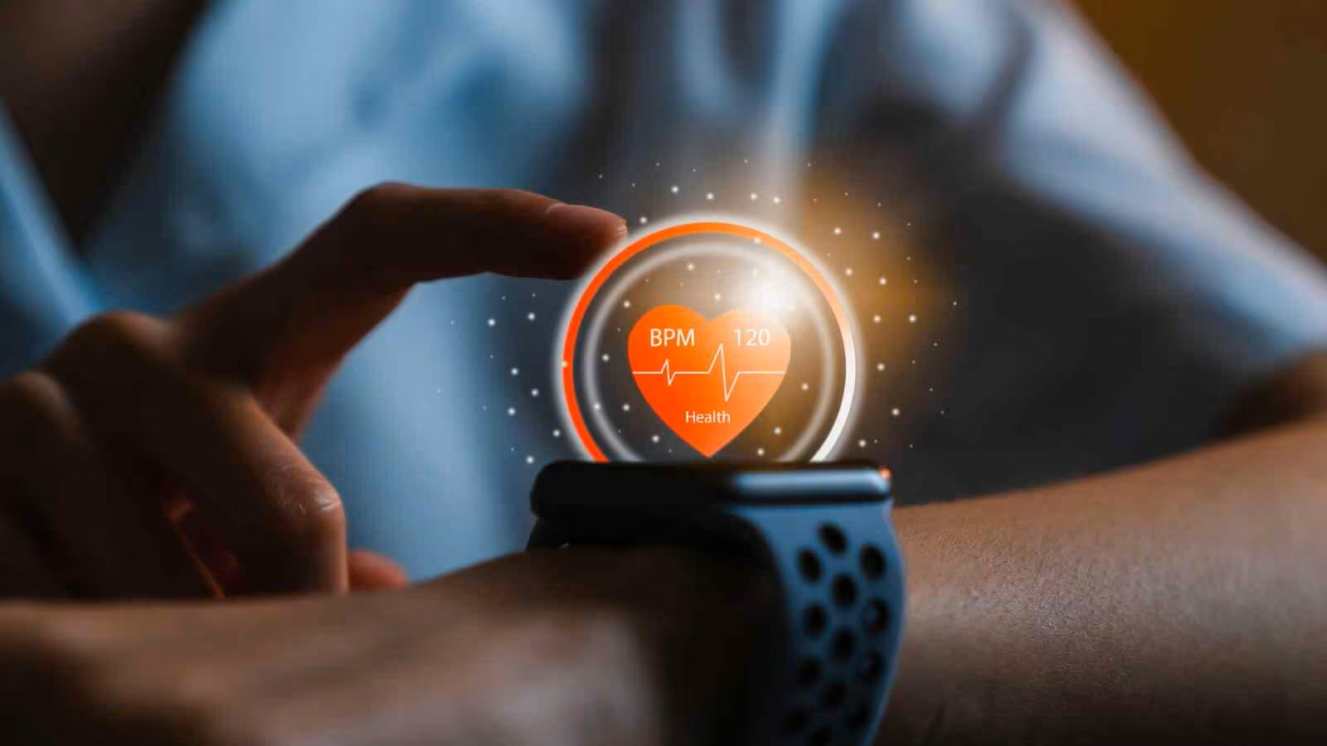
WEARABLE HEALTH DEVICE PERFORMANCE
SUBMITTED BY
SREELAKSHMI K
DATA ANALYTICS
MS EXCEL

Slide 2
INTRODUCTION
Wearable health devices are widely used to track daily health and fitness activities such as heart rate, steps, sleep, and calories. These devices help users monitor their health and improve their lifestyle.
This project analyzes the performance of different wearable health device brands using Excel. By studying battery life, accuracy, price, and performance score, the analysis helps compare devices and understand which brands offer better value and reliability.

Slide 3
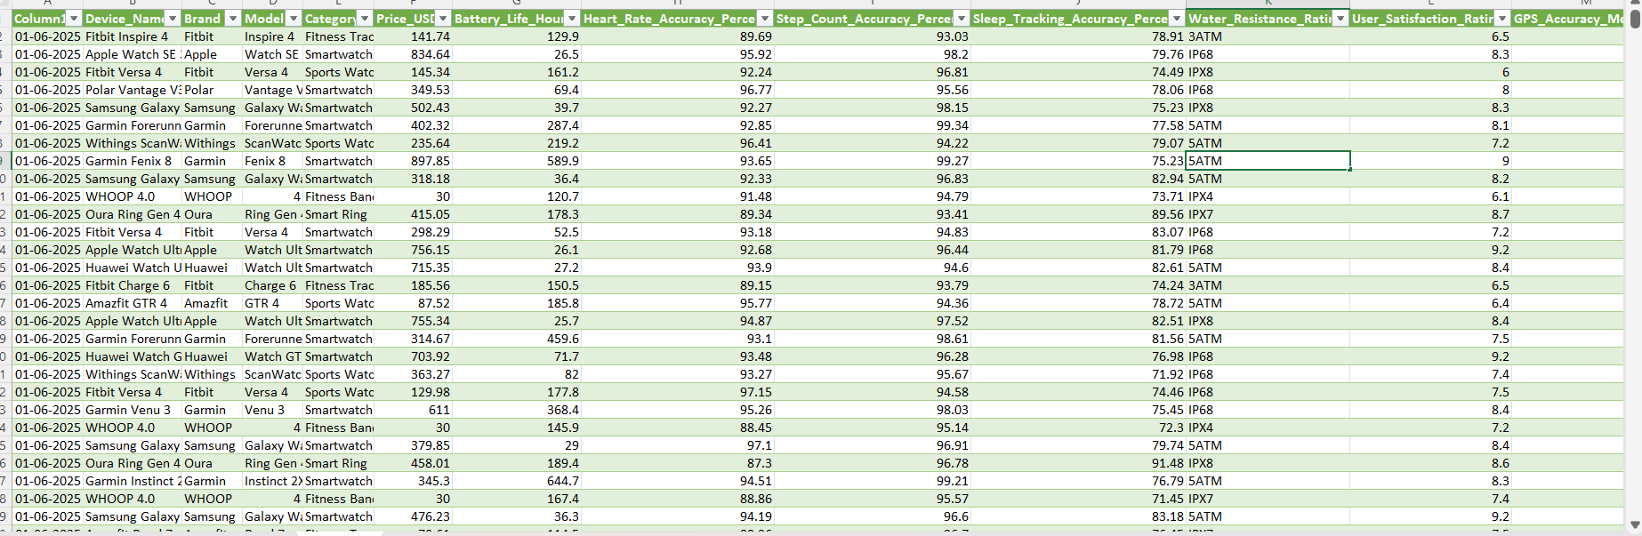
DATASET

Slide 4
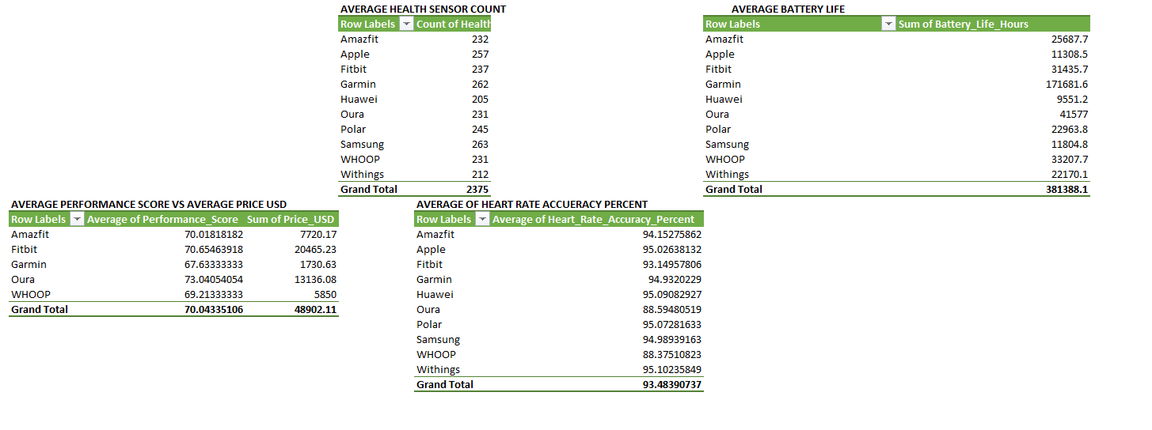
PIVOT TABLES

Slide 5
CRITERIA USED
Average Health Sensor Count Based on Brand
Average Battery Life For Each Brand
Average Performance VS Sum Of Price USD
Average Of Heart Rate Accuracy Rate

Slide 6
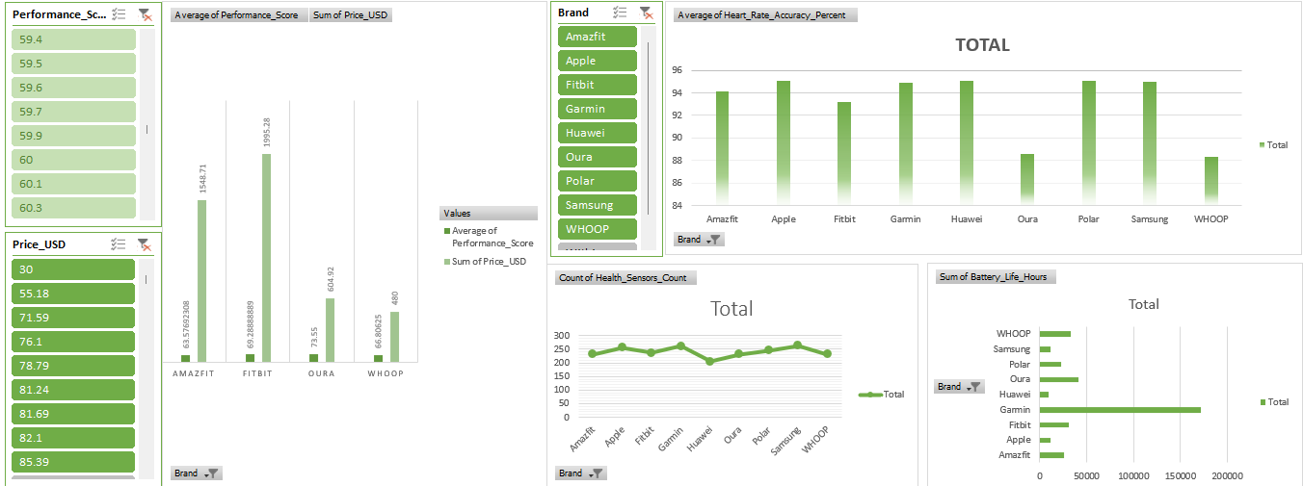
DASH BOARD

Slide 7
CONCLUSION
Wearable device performance varies by brand and purpose
Garmin excels in battery life, while Apple leads in accuracy
Fitbit and Amazfit are cost-effective options
Data analysis helps users choose devices based on their need

Slide 8
SUGGESTIONS
Improve battery life so users can use the device longer
Keep price reasonable compared to performance
Increase accuracy of health sensors like heart rate and sleep
Focus on user comfort and easy usage

Slide 9
REFERENCES
https://www.kaggle.com/datasets/pratyushpuri/wearable-health-devices-performance-analysis
Microsoft Excel

Slide 10
THANK YOU

